Slide 1
Simulation
Agent-based modeling

Slide 2
Main idea
Structure
MODELING
SYSTEM
SYSTEM
ProcessEvent(…)
agent
agent
ProcessEvent(…)
agent
agent
agent
agent
ProcessEvent(…)
…
agent
agent
agent
agent
agent
agent
agent

Slide 3
Four rules of an agent
each agent is individual, that is, it has its own set of characteristics and rules of behavior;
each agent is autonomous and can independently make decisions on its further actions;
an agent can interact with other agents to obtain information, adjust its behavior or notify other agents that its state was changed;
an agent must be in some environment that allows him to interact with other agents.

Slide 4
Example
Queueing system (QS)
Система массового обслуживания (СМО)

Slide 5
Model
Bank
operator
Customers
operator
queue
…
operator

Slide 6
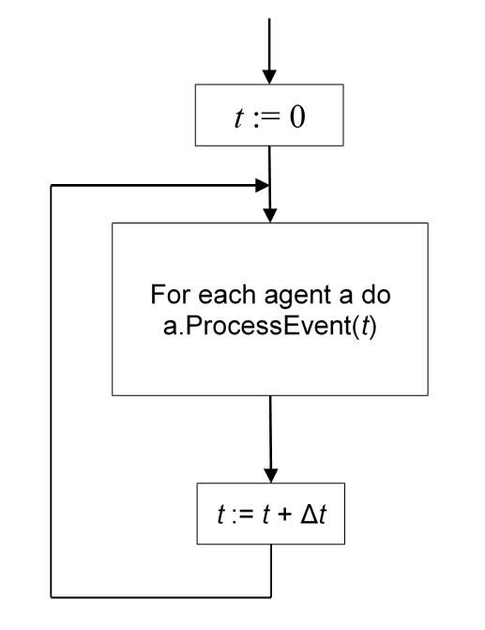
Continuous modeling
Use constant time slot Δt
a determines here is it time to do smth. or not.
If yes, then it does.

Slide 7
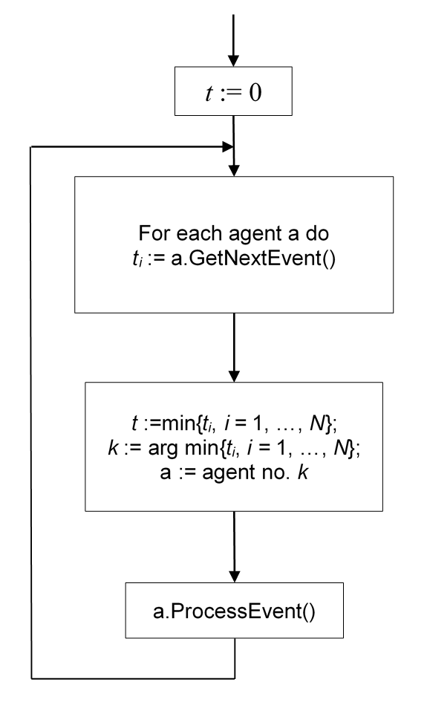
Discrete-event modeling
returns time instant when a should do smth.
a do planned smth.

Slide 8
Model: who can be an agent?
Where are the agents here?
Bank
operator
Customers
operator
queue
…
operator

Slide 9

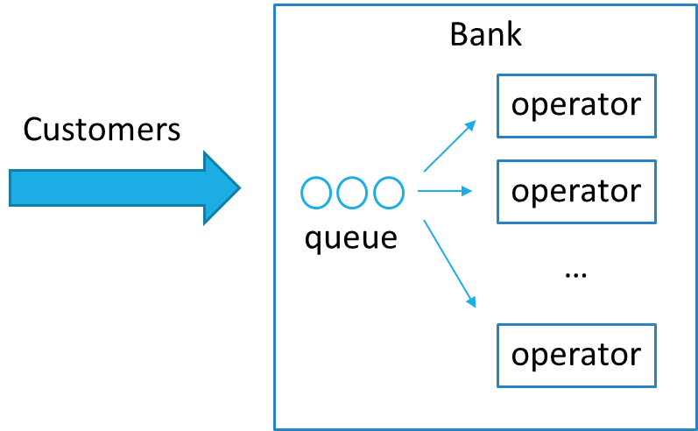
Laboratory #18 (the last ☺ )
Assignment:
Bank office
Model is as described in lectures.
Use agent-based modeling on base of discrete-event approach.
B A N K

